Slide 1
Grade 9th-12th – Lesson 1
The Heart of a Watershed
Notes:
Ask students : What is a watershed? (A region draining into a river, river system, or other body of water.)

Slide 2
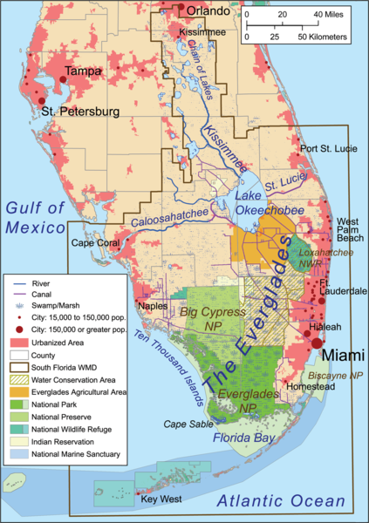
Where is The Everglades?
Notes:
Stop and ask students: Where is the Everglades? Answers will vary. Point out that the historical Everglades once started just below Orlando in the Chain of Lakes and stretched all though southern Florida to the Florida Bay. Students will be surprised to learn that they actually live in the Everglades.
Tell students that this area is known as the K-O-E watershed - Kissimmee - Lake Okeechobee - Everglades watershed, an area of about 9,000 square miles that once extended as a single hydrologic unit from present-day Orlando 250 miles south to Florida Bay.
Everglades Area Map
https://commons.wikimedia.org/wiki/File:Evergladesareamap.png
Kmusser
CC BY SA 3.0

Slide 3
Let’s Create an Everglades Word Web
Vocabulary:
Channelization
Divide
Drainage basin
K-O-E watershed
Swamp and Overflow Land Act of 1850
Watershed
Notes:
We would like to begin today by accessing your prior knowledge about the Everglades.
Activity: In small groups, have students use the suggested vocabulary words to develop word webs and then a quick sharing out to make a whole group word web. Optional activity – have students look up vocabulary words.

Slide 4
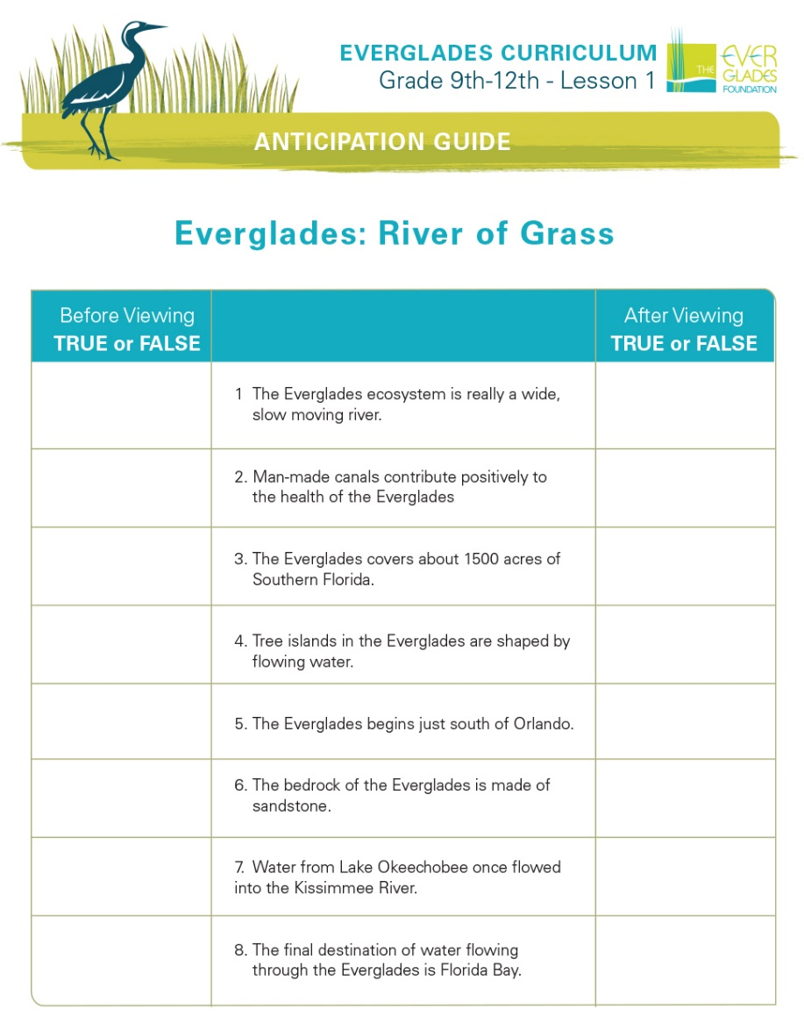
Anticipation Guide
Notes:
Tell students to take a moment to jot down the answers on a post it or piece of scrap paper before watching the video.
Tell them to notice from the video how humans have altered the historical system and to consider as they watch how those alterations would affect the flora and fauna that is there. Ask them to also think about how these changes would affect them personally.
EvergladesFoundation, 2015.AnticipationGuide.Palmetto Bay FL

Slide 5
The Everglades: River of Grass Video
The Everglades: River of Grass video
Notes:
Do Anticipation Guide

Slide 6
Anticipation Guide
Notes:
Revisit anticipation guide
Now look at your answers – would any of them change?
EvergladesFoundation, 2015.AnticipationGuide.Palmetto Bay FL

Slide 7
Historic Everglades
The Everglades was once a once a vast, free-flowing river of grass extending from the Kissimmee chain of lakes to Florida Bay covering almost nine million acres.
These sub-tropical wetlands supported a rich diversity of plants, fish and other animals.
Water ran from the Kissimmee River into Lake Okeechobee, and then filtered down through the Everglades to the Florida Bay. The water that moved down the flat and level surface landscape flowed so slowly that, in effect, it was stored from one season for use in another.
Because of this slow flow in the natural system, summer rains kept wetlands flooded and “stored” freshwater from one season to another.
Notes:
ST - Flooding – in 1903 - Napoleon Bonaparte Broward was elected and promised to “drain that abominable, pestilence-ridden swamp.”
1926 to 1928 brought a series of major hurricanes that caused extensive flooding and killed 2,500 people. The Army Corps of Engineers was authorized by the state in 1930 to undertake flood control measures for the rest of the Everglades (Dugger, 1996).
More hurricanes in 1947 and 1948. These storms were more severe, drowning over 2,000 and 25,000 cattle and leaving agriculture and urban land flooded for six months.
ACOE motto: Four D’s: “Dike it, Dam it, Divert it, and Drain it.”
in 1948 the Central and Southern Florida Project for Flood Control and Other Purposes (C&SF) was created and run by the ACOE. The C&SF divided up the Everglades into three districts, the Everglades Agricultural Area (EAA), Water Conservation Areas (WCAs), and the Everglades National Park (actually created in 1947).

Slide 8
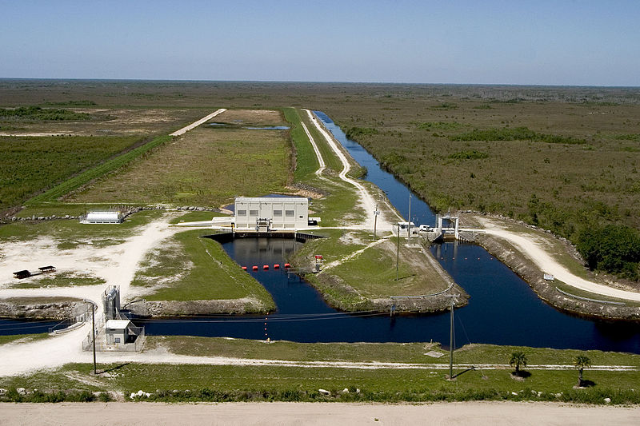
Altered Everglades
Since the mid 1800s, as more people began moving into Florida, the natural Everglades systems have been altered.
Notes:
ST - Flooding – in 1903 - Napoleon Bonaparte Broward was elected and promised to “drain that abominable, pestilence-ridden swamp.”
1926 to 1928 brought a series of major hurricanes that caused extensive flooding and killed 2,500 people. The Army Corps of Engineers was authorized by the state in 1930 to undertake flood control measures for the rest of the Everglades (Dugger, 1996).
More hurricanes in 1947 and 1948. These storms were more severe, drowning over 2,000 and 25,000 cattle and leaving agriculture and urban land flooded for six months.
ACOE motto: Four D’s: “Dike it, Dam it, Divert it, and Drain it.”
In 1948 the Central and Southern Florida Project for Flood Control and Other Purposes (C&SF) was created and run by the ACOE. The C&SF divided up the Everglades into three districts, the Everglades Agricultural Area (
Everglades Dike Picture
https://commons.wikimedia.org/wiki/File:Levees,_Dikes_and_Dams_(20),_NPSPhoto,_R._Cammauf_(9247356437).jpg
Everglades NPS from Homestead, Florida, United States
Public Domain

Slide 9
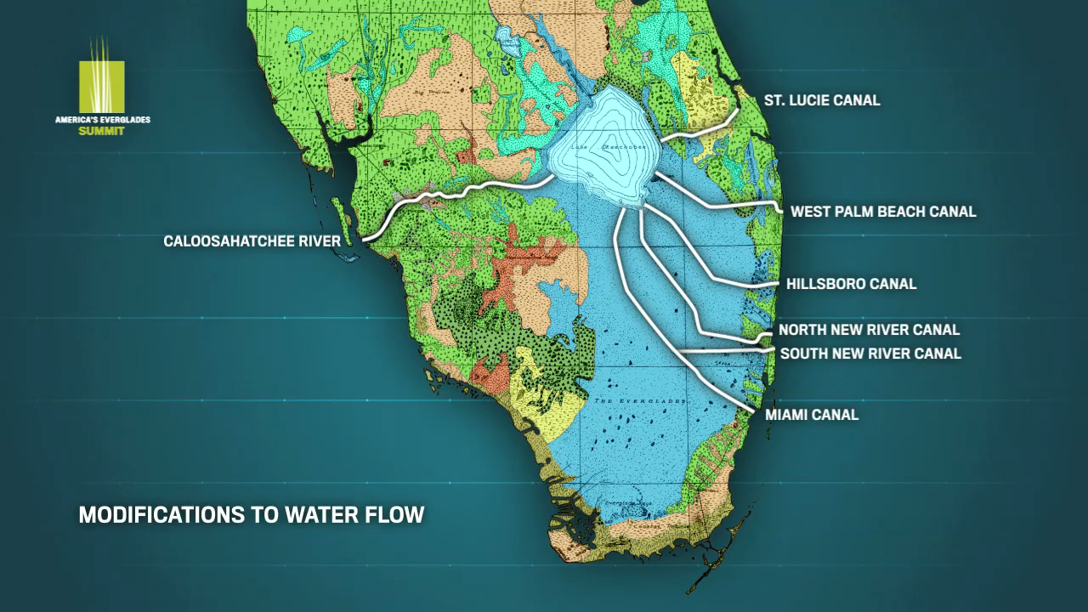
Modifications To Water Flow
Notes:
1926 to 1928 brought a series of major hurricanes that caused extensive flooding and killed 2,500 people. The Army Corps of Engineers was authorized by the state in 1930 to undertake flood control measures for the rest of the Everglades (Dugger, 1996).
Redline shows track of hurricane
Map: EvergladesFoundation,2015.ModificationstoWaterFlow.InternalProduction.Palmetto Bay FL

Slide 10
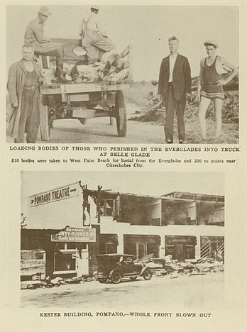
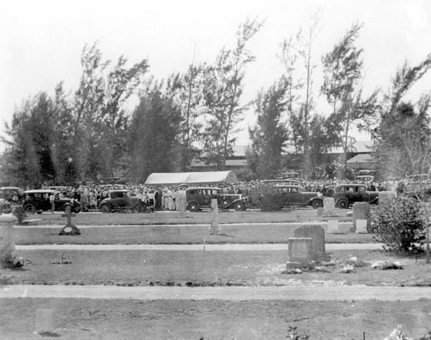
1928 Hurricane Aftermath
Massive destruction just two years after 1926 Hurricane
2,500 lives lost
The U.S Army Corps of Engineers was ordered to help
Notes:
Left picture
1928 Hurricane Okeechobee Aftermath
https://commons.wikimedia.org/wiki/File:1928_Okeechobee_Aftermath_7.jpg
Jdorje~commonswiki
Public Domain
Right picture
1928 Hurricane Burial
https://en.wikipedia.org/wiki/File:Burial_of_victims_of_the_1928_hurricane-_West_Palm_Beach,_Florida_(3674596695).jpg
Florida Memory
Public Domain

Slide 11
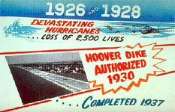
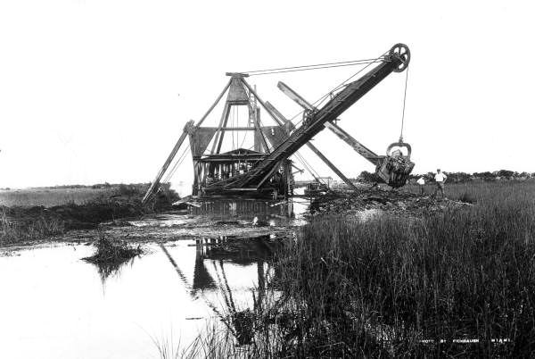
Altered Everglades
Notes:
The Herbert Hoover Dike is an earthen dam that surrounds Lake Okeechobee.
It’s 140-miles long and was built to hold back water draining from lands within the watershed.
Slide courtesy of Alana Edwards
Hoover Dike Sign
https://en.wikipedia.org/wiki/File:Army_CoE_sign_Hoover_Dike.jpg
U.S. Army Corps of Engineers
Public Domain
Dredge Tamiami
https://commons.wikimedia.org/wiki/File:Dredge_at_work_on_the_Tamiami_Trail_(8976529209).jpg
State Library and Archives of Florida
Public Domain

Slide 12
Altered Everglades
Today, all water movement in and out of the lake and through the Everglades system, except local rainfall, is controlled by water managers.
There are 1,800 miles of canals and dams with water control points; pump stations divert the natural flow of water.
The Everglades Story
Notes:
ST - Flooding – in 1903 - Napoleon Bonaparte Broward was elected and promised to “drain that abominable, pestilence-ridden swamp.”
1926 to 1928 brought a series of major hurricanes that caused extensive flooding and killed 2,500 people. The Army Corps of Engineers was authorized by the state in 1930 to undertake flood control measures for the rest of the Everglades (Dugger, 1996).
More hurricanes in 1947 and 1948. These storms were more severe, drowning over 2,000 and 25,000 cattle and leaving agriculture and urban land flooded for six months.
ACOE motto: Four D’s: “Dike it, Dam it, Divert it, and Drain it.”
In 1948 the Central and Southern Florida Project for Flood Control and Other Purposes (C&SF) was created and run by the ACOE. The C&SF divided up the Everglades into three districts, the Everglades Agricultural Area (

Slide 13
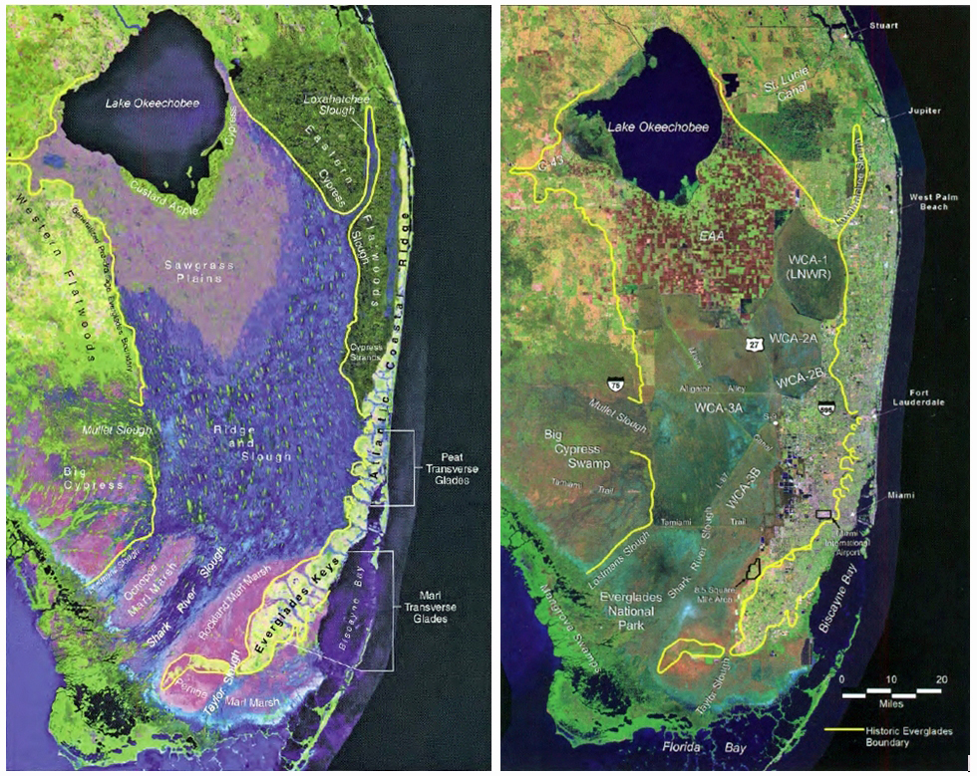
Ecological Collapse
Central & South Florida Projects provide 8 million people with:
    Flood control
    Water supply
Ecological Collapse
    Loss of 90% of wading birds
    > 70 threatened or endangered species
    Extensive pollution
    Hyper-saline bays
Notes:
This is a recap of some of the important changes that were made to this system. Point out that the original plan was to accommodate 2 million people by the year 2000, but in reality the number was over 7.5 million.
Central and Southern Florida Flood Control District formed in 1949.
The project was intended to provide water for ~2 million people in the year 2000.
1950-1960 – 128 miles of canals and 300 miles of levees were built.
700.000 acres of farmland in the EAA.
By 2000, there were 7.5 million living in the SFWMD.
EvergladesFoundation,2015.InternalProduction.Palmetto Bay FL

Slide 14
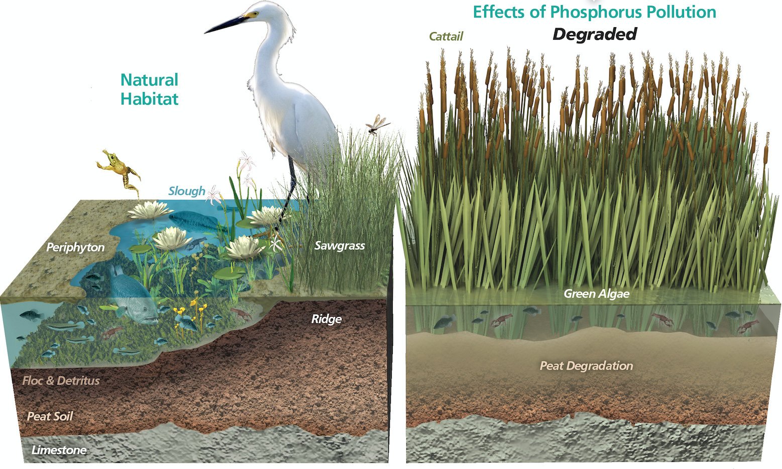
Water Quality: Cascading Effects of Phosphorous Pollution
When phosphorus is greater than 10 parts per billion
When phosphorus is less than 10 parts per billion
Notes:
Image compares two habitats one with phosphorus under 10 PPB and one loaded with phosphorus.
EvergladesFoundation, 2015.Water Quality.InternalProduction.Palmetto Bay FL

Slide 15
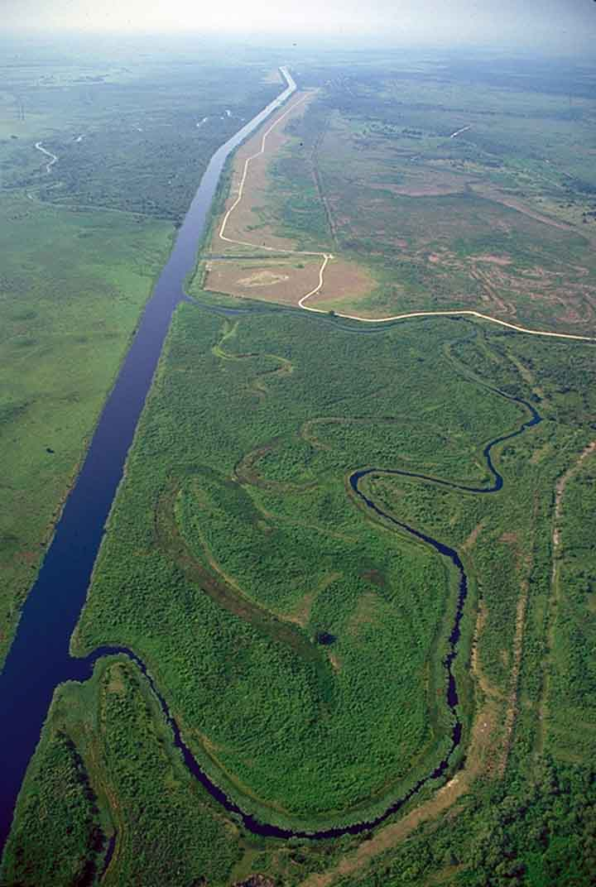
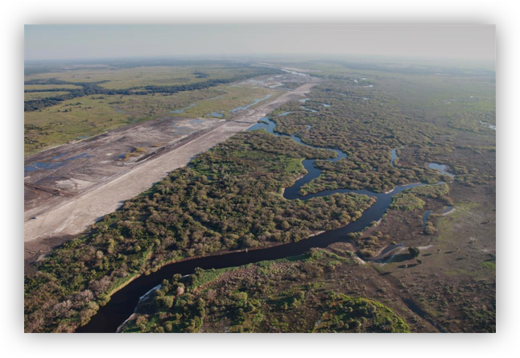
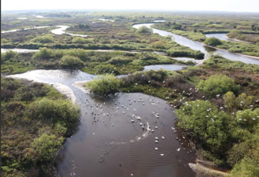
Restoration is Working
Notes:
One alteration that was made was to channelize the Kissimmee River. Point out that Channelization means- Reducing the length of the channel by substituting straight cuts for the original winding course. Tell students the purpose of this was to cut down the mileage so that barges carrying goods could get through quicker.
The river was deepened and straightened, eliminating the natural flood plane. This affected the natural flow.
It also affected the wildlife that lived there, as the faster flow and deeper water altered the natural habitats.
EvergladesFoundation,2015.InternalProduction.Palmetto Bay FL

Slide 16
Issues Affecting Lake Okeechobee
Three major issues affect Lake Okeechobee:
Lake Levels
Nutrients
Exotics
Notes:
The three major issues affecting Lake Okeechobee’s natural balance are lake levels, nutrients, and exotics.
A dike was built around Lake Okeechobee and the surrounding land was developed into agricultural area. Run off from the se areas brought pollutants (such as phosphorus from fertilizer) into the lake.

Slide 17
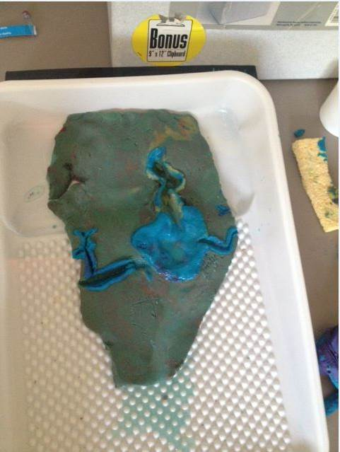
Making a Model of the Historic Everglades
In groups of 3-4, make two models:
Historic Everglades
Present day Altered Everglades
Notes:
Answers will vary – but should reflect that the fresh water that was once available to the ecosystems is being sent out to the ocean, and is no longer available. The steady flow of water that once sustained these ecosystems throughout the dry season has been cut off, causing drought conditions. The water that once flowed down and then recharged our aquifer is now being dumped into the ocean, and not allowed to trickle down to the water supply.
Personally, students might say that they will be affected by a shortage of water as populations grow, by loss of sport fishing and availability of fish as a food source, air quality hazards from algae blooms, etc.

Slide 18
Wrap Up - Discussion
What do you think were the effects of altering the natural systems (the channelization of the Kissimmee River and the altered flow through the Caloosahatchee River and St. Lucie River) on the Everglades ecosystems?
How do you think these alterations have or will affect you personally, as well as other people in southern Florida?
Notes:
Answers will vary – but should reflect that the fresh water that was once available to the ecosystems is being sent out to the ocean, and is no longer available. The steady flow of water that once sustained these ecosystems throughout the dry season has been cut off, causing drought conditions. The water that once flowed down and then recharged our aquifer is now being dumped into the ocean, and not allowed to trickle down to the water supply.
Personally, students might say that they will be affected by a shortage of water as populations grow, by loss of sport fishing and availability of fish as a food source, air quality hazards from algae blooms, etc.

Slide 19
Assessment
Draw diagrams of both models and label the components of each model.
Write a summary paragraph that compares the historic flow of water through the greater Everglades ecosystem with the present day flow.

