Slide 1
A Question of Quality– Lesson 2
Stormwater Treatment Areas
Managing Phosphorous in the Everglades

Slide 2
“Excess nutrients found in stormwater runoff pose a risk to the Everglades. These nutrients flow from lawns, farms, roadways and other developed areas. Stormwater Treatment Areas are constructed wetlands that remove excess nutrients. They play a vital role in protecting and restoring America’s Everglades.”
From: Below the surface- an in depth look at Everglades Stormwater Treatment Areas. www.sfwmd.gov

Slide 3
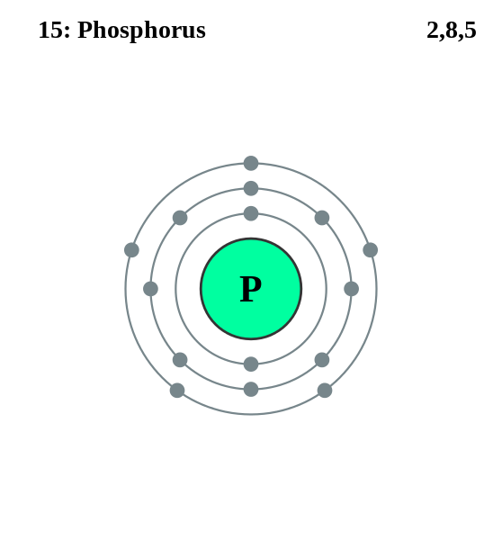
Phosphorus
Phosphorus, chemical symbol P, atomic number 15, is one of the 94 naturally occurring elements
It is used in a broad variety of industries and is an essential nutrient to almost every life form on Earth
Notes:
Phosphorus
https://commons.wikimedia.org/wiki/File:Electron_shell_015_Phosphorus.svg
Greg Robson
CC BY SA 2.0

Slide 4
Phosphorus in the Everglades
Phosphorus levels historically were low in the Everglades (< 10ppb), and native wetland plants are adapted to this and can thrive there
When excess amounts of phosphorus enters the Everglades from stormwater runoff, it can put this fragile ecosystem at risk

Slide 5
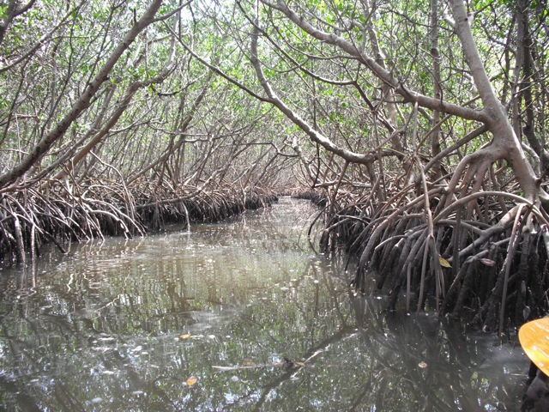
Phosphorus in the Everglades
High concentrations of phosphorus can cause rapid and extensive growth of aquatic plants and algae, leading to depletion of oxygen dissolved in the water. This adversely affects animal populations, such as fish.
Notes:
Mangrove Swamp Common Plants
https://en.wikipedia.org/wiki/File:FL-Mangrove-clw.jpg
Epeterson1222
Public Domain

Slide 6
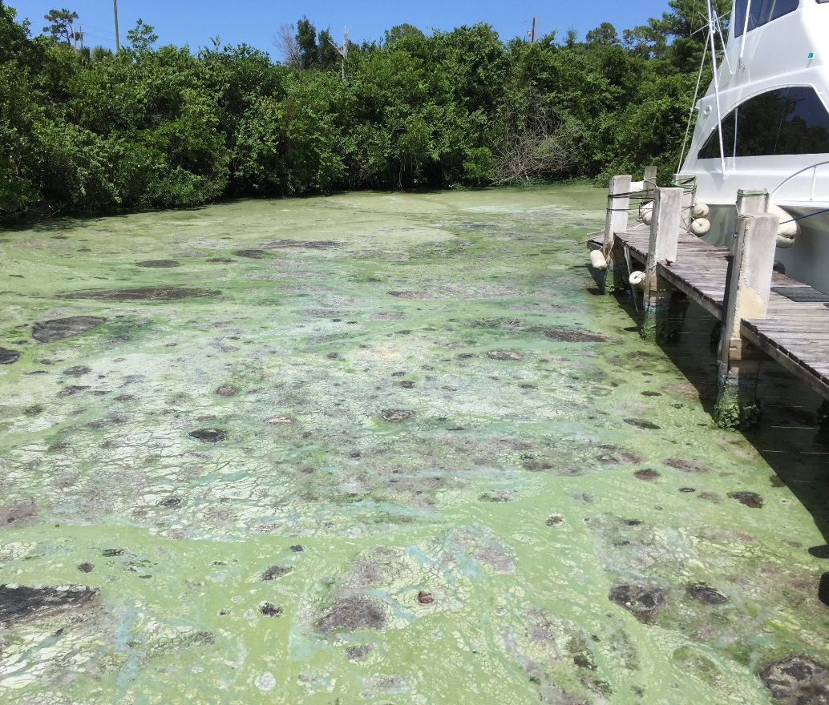
Phosphorus in the Everglades
Excessive plant and algae growth can also raise the pH of a water body, altering the ecosystem water chemistry and causing an imbalance of microbial bacteria. High phosphorus concentrations favor the growth of simple algae and plankton over more complicated plants, reducing species diversity
Notes:
EvergladesFoundation,2016.AlgalBloom.InternalProduction.Palmetto Bay FL

Slide 7
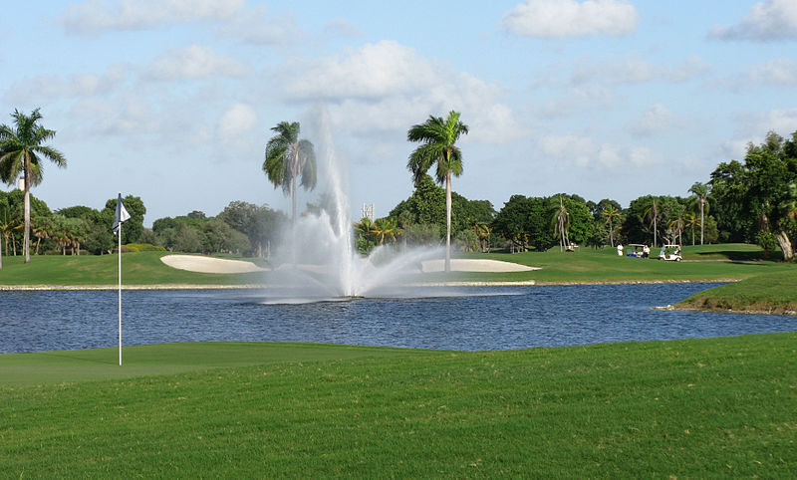
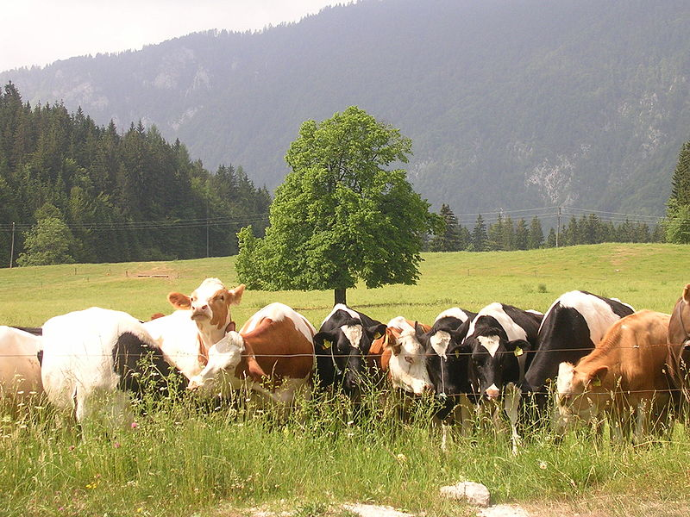
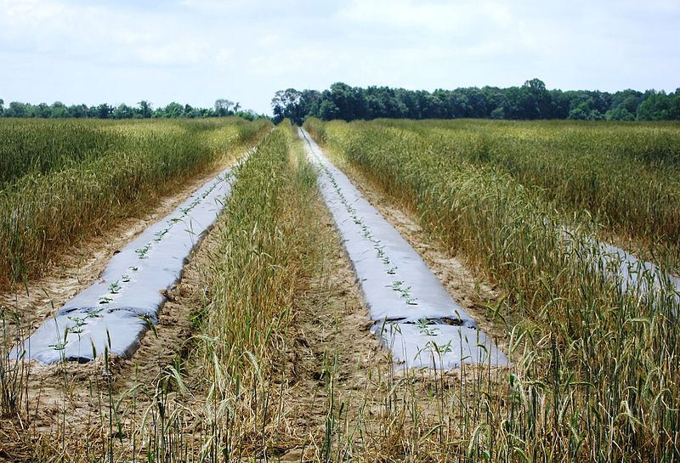
Sources of Phosphorus Pollution
Runoff from residential developments, roadways, commercial areas, and fertilization of landscapes, yards, and golf courses
Agricultural livestock
Agricultural row crops
Notes:
Golf course
https://commons.wikimedia.org/wiki/File:DoralGolfResortNovember2010.jpg
Cfmyers
Public Domain
Cows
https://commons.wikimedia.org/wiki/File:Cows_on_Me%C5%BEakla.jpg
Mihael Simonič
CC BY 3.0
Row Crops
https://commons.wikimedia.org/wiki/File:Mixed_Crops_row_by_row_-_panoramio.jpg
Art Anderson
CC BY SA 3.0

Slide 8
Investing in a Solution
The State of Florida has invested more than $1.8 billion in water quality improvements aimed at lowering phosphorus levels.
The 1994 Florida Forever Act mandated and funded construction of Stormwater Treatment Areas (STA’s)
So far 57,000 acres of land south of Lake Okeechobee have been converted to STA’s.

Slide 9
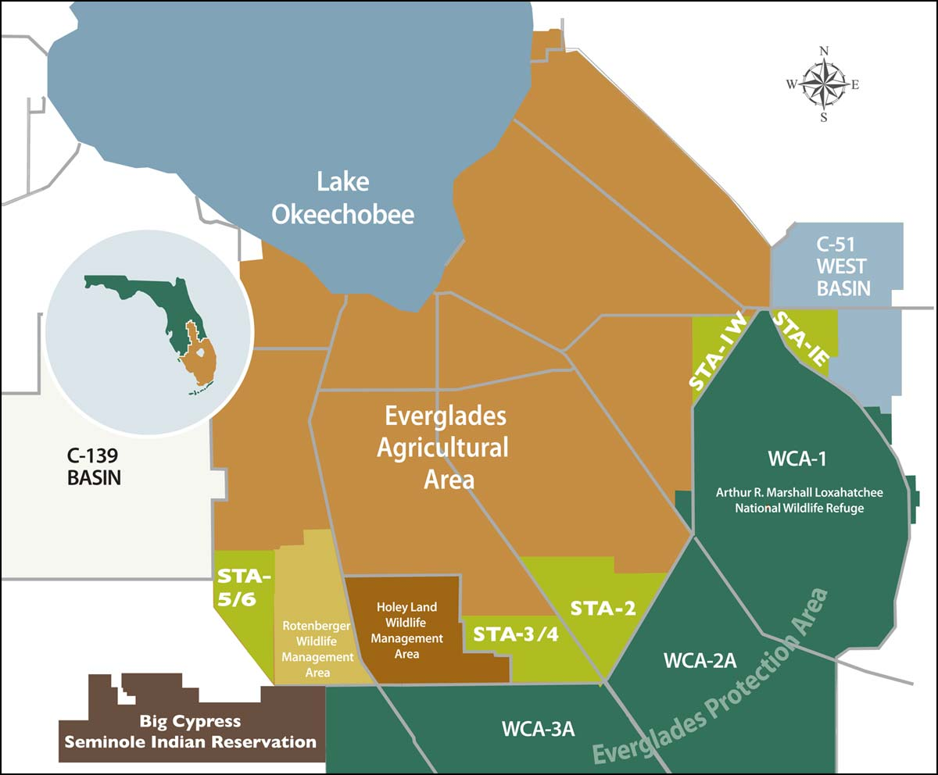
Video: Stormwater Treatment Areas
https://www.youtube.com/watch?v=FeUHSRzUYcE
South Florida Water Management District: https://www.sfwmd.gov/our-work/wq-stas
Notes:
STA
https://www.sfwmd.gov/our-work/wq-stas
South Florida Water Management District
Public Domain

Slide 10
How STAs Work
Stormwater Treatment Areas have a specialized cleansing function
Wetland plants, such as cattail, southern naiad and algae in the STA uptake phosphorus and store it in their roots, stems and leaves
The water leaving the STA has significantly less phosphorus than the stormwater runoff water flowing in

Slide 11
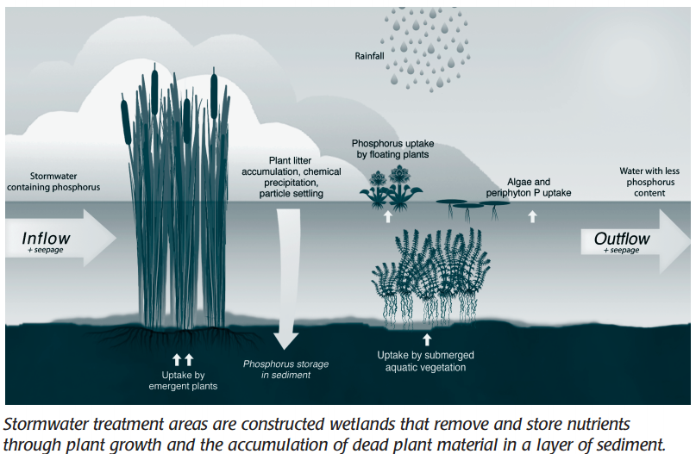
South Florida Water Management District. Below the Surface. Retrieved December 2016 from https://www.sfwmd.gov/sites/default/files/documents/bts_sta.pdf
Notes:
South Florida Water Management District. Below the Surface. Retrieved December 2016 from https://www.sfwmd.gov/sites/default/files/documents/bts_sta.pdf

Slide 12
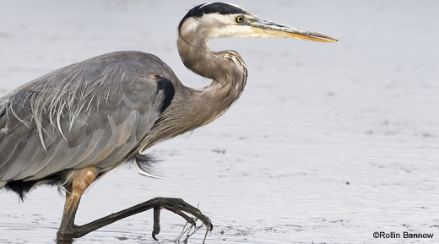
Wildlife in the Wetlands
In addition to improving Everglades water quality, the shallow water in STAs make an ideal habitat for wildlife
Notes:
Great Blue Heron
https://www.fws.gov/refuge/julia_butler_hansen/wildlife_and_habitat/habitats/birds/great_blue_heron.html
Credit: U.S. Fish and Wildlife Service
Photo by
Rollin Bannow/USFWS
Public Domain
https://www.fws.gov/help/disclaimer.html

Slide 13
By building the STAs in key areas north of the Everglades, phosphorus can be reduced before it flows south into protected wetlands
Notes:
STA
https://www.sfwmd.gov/our-work/wq-stas
South Florida Water Management District
Public Domain

Slide 14
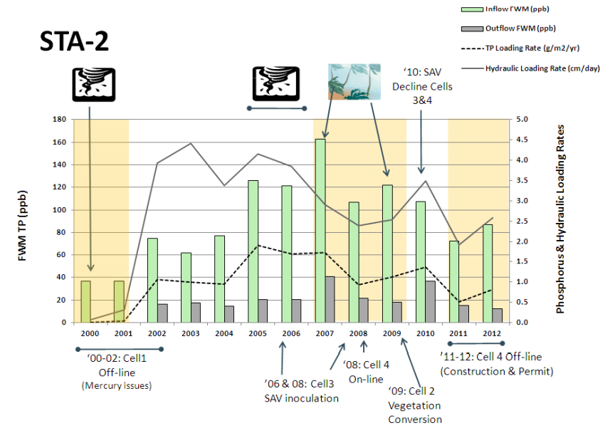
STA-2
Source: Pietro, K. (2012). Synopsis of the Everglades Stormwater Treatment Areas, Water Year 1996–2012. South Florida Water Management District.
Retrieved Dec, 2016 from:
http://www.wwwalker.net/ever/stas/pdfs/references/STA_Synopsis_1996-2012_ASB-WQTT-12-001.pdf
Notes:
This diagram shows the average total phosphorus for STA-2 by water year (May – April) with major weather events depicted. The tan shading means drought, the funnel icon means hurricane impacts, and the palm trees mean tropical storms.
Source: Pietro, K. (2012). Synopsis of the Everglades Stormwater Treatment Areas, Water Year 1996–2012. South Florida Water Management District.
Retrieved Dec, 2016 from:
http://www.wwwalker.net/ever/stas/pdfs/references/STA_Synopsis_1996-2012_ASB-WQTT-12-001.pdf

Slide 15
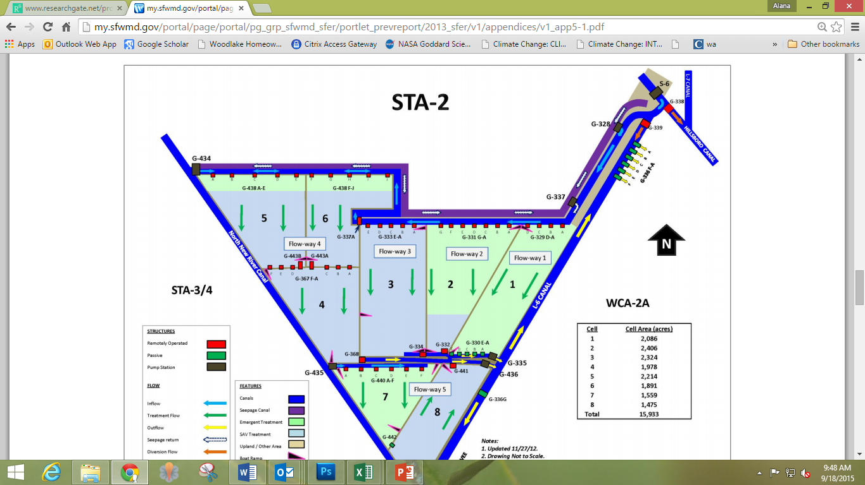
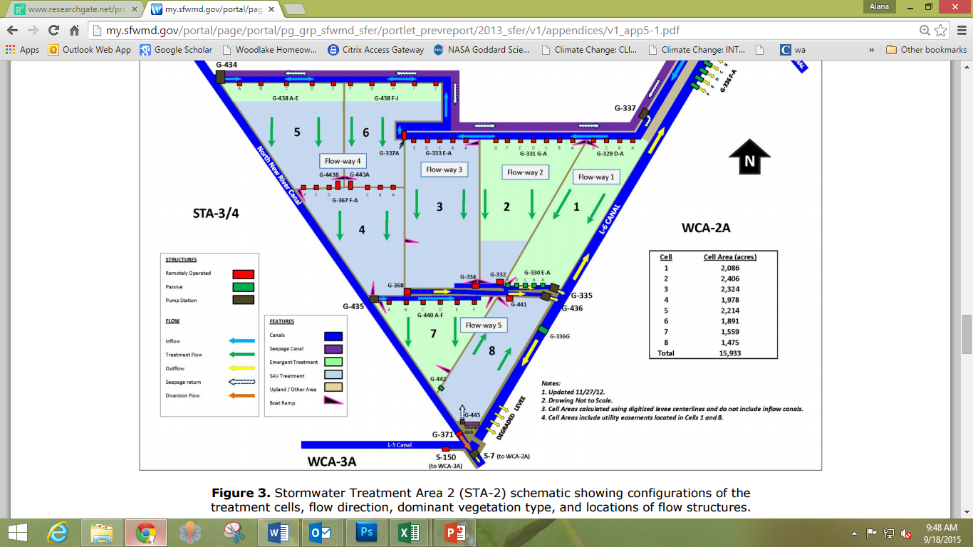
STA-2
Notes:
This slide shows the flow of water for STA-2. Water enters the cell from the Hillsboro canal at the north end, at G333 and flows south through the vegetation until it is pumped out of the cell at G334 at the southern end. This cell is just over 3 miles in length. If water through these cells are averaging ~1/2 mile per day, then the water coming in at the top would exit ~ one week later.
Source: Pietro, K. (2012). Synopsis of the Everglades Stormwater Treatment Areas, Water Year 1996–2012. South Florida Water Management District.
Retrieved Dec, 2016 from:
http://www.wwwalker.net/ever/stas/pdfs/references/STA_Synopsis_1996-2012_ASB-WQTT-12-001.pdf

Slide 16
Assignment
You will look at data from STA- 2 Cell 3 from 2012 to see how it performed
Tp in = Total phosphorus in (in ppb)
Tp Out = Total Phosphorus out (in ppb)
Flow = water flow in cfs (cubic feet per second)
Note: To visualize cfs, think of 100 basketballs per second flowing past you!
Notes:
EvergladesFoundation,2016.WaterFlow.InternalProduction.Palmetto Bay FL

Slide 17
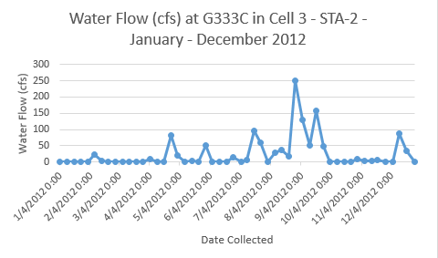
Notes:
EvergladesFoundation,2016.WaterFlow.InternalProduction.Palmetto Bay FL

Slide 18
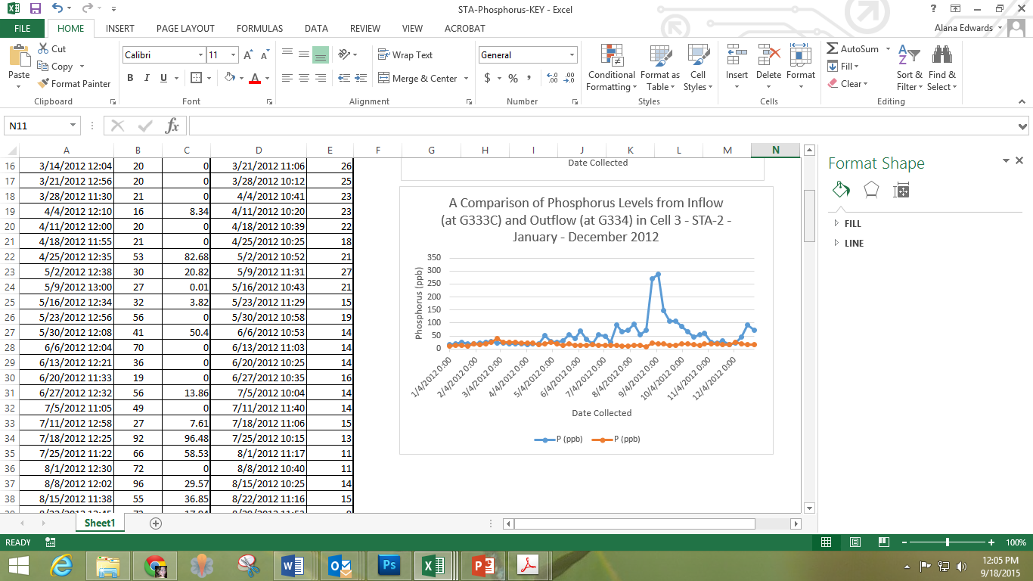
Notes:
EvergladesFoundation,2016.PhosphorusLevels.InternalProduction.Palmetto Bay FL

Slide 19
Notes:
EvergladesFoundation,2016.WaterFlow.InternalProduction.Palmetto Bay FL
EvergladesFoundation,2016.PhosphorusLevels.InternalProduction.Palmetto Bay FL

Slide 20
Why is Water Quality Important to the Everglades?
High concentrations of phosphorus can cause rapid and extensive growth of certain aquatic plants and algae, leading to depletion of oxygen dissolved in the water
Plant communities are changing because of excess nutrient load. Sawgrass is being crowded out because of nuisance native plants like the cattails. Everglades ecosystems such as the sawgrass marsh are adapted to low nutrient levels. By adding excess phosphorus
This adversely affects animal populations. Cattails grow too thick for birds or alligators to nest in, and depleted oxygen levels and increased algae growth prohibits the growth of native invertebrates on the bottom of the food chain

